Slide 1

the cheapest flight Package
TKS Solutions
Brought to you by Thomas, Kwon, and Smith

Slide 2





The Problem
Transportation
Financial
Quality/Durability
Cost
Efficiency and Ease-of-Use
Being at the right place at the right time. Its not just an old saying..
It is no secret that flights can be expensive. As a business, traveling expenses can creep up on your financials.
Finding a solution that not only works, but will work consistently and is easy to use.
Competitive prices help you with the goal…making money.
Our program is expertly designed to avoid slowing down your computer, and it is incredibly easy to use..just like riding a bike.

Slide 3



Solution
Install Program
Train User
Savings
Installation is as simple as downloading a python file.
Training can be completed in approximately ten minutes
Sleep well at night knowing you are saving money.
Buy our program and follow these steps to success
.

Slide 4
About Us
Efficiency
Our program is technically designed to reduce computing time, keeping your computer running as it should
Ease of Use
The user will need very basic knowledge of opening and closing Python and Anaconda files, but will require no coding knowledge
Our program can be summarized in just 5 simple steps, as explained later
While this knowledge may seem burdensome, it is a tremednous help to the user because…
Our program will record and output to the excel file as many trips as the user desires, making for easy comparison of travel options
The user can place the data for the flight fares anywhere in the spreadsheet as long as it begins in a column A-Z
Durability
We claim that no user input error will crash our program as we will demonstrate later
If for some reason, the user fails to enter in data correctly, they will be clearly directed by a prompt on the console
We sought a product that is efficient, easy to use, and fool proof.

Slide 5
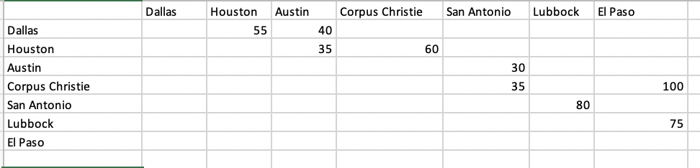
Functioning the program Data Formatting
The data MUST be entered in the following manner
Note the city names as columns headers and row labels
An entry in a cell means there is a direct flight between the two cities at the specified cost
Empty cells mean there is no direct flight between the two cities
During installation, our team will save the directory of your excel file into the program. Refer to user manual if you change the directory path.

Slide 6

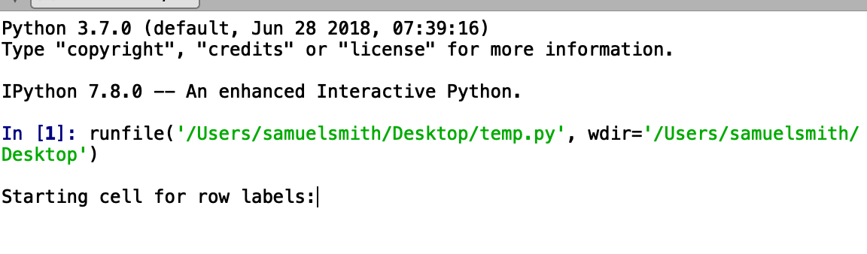
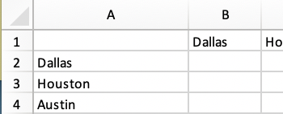
The Five simple steps
Step One:
Open the file titled (Title) & Click the green Play button located at the top of the python file
Step Two:
Enter the 1st cell of the row labels (e.g. A2 from the Texas Airways Example)

Slide 7
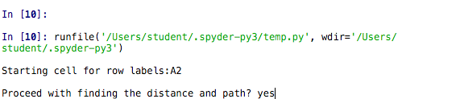
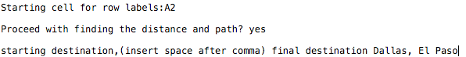
Executing the PRogram
Step Three:
Type in yes when prompted with question to finding distance and path
Step Four:
Enter starting city and final destination, separated by a comma and a space in between
Step five
When asked to continue, enter yes to find another least-cost flight or no to stop the program

Slide 8
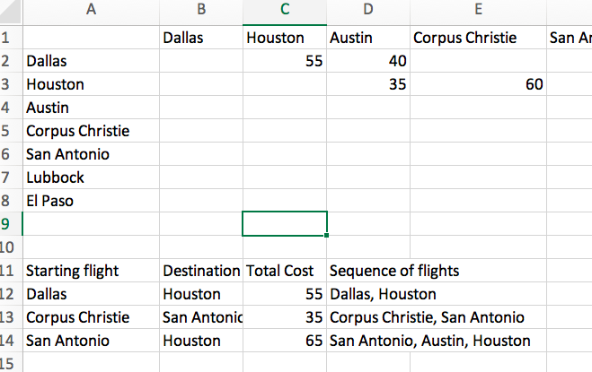
Excel Output
After you run the program, a history log of the least cost flights you entered is displayed to the excel spreadsheet.
Information displayed:
Starting flight in column A
Destination in column B
Total cost in column c
Sequence of flights in column D

Slide 9
Demonstrations
Outline of demonstrations
Phase 1 Basic Run Through
Phase 2 Advanced Run Through
Phase 3 Try to Crash Program
Show the user how to function the program
Explain the output in excel
Show that it works correctly
Demonstrate Key features
Key Features:
Will work for any location of the data in the spreadsheet
Output several results for comparison
Erases results each time you run the program
Show how it responds to changes in the number of cities
Run through scenarios in which it could possibly crash
Demonstrate durability
Show how easy it is to respond in various scenarios.

Slide 10




Competition Options
TKS Solutions
Performance
Number of Stevens in the Group

